Slide 1


Developing Hybrid Multilayer Films with Chiral Magnets and Superconductors
Name: Phee Yong Han
Date: 21/07/2022

Slide 2


Background
Superconductors

Slide 3
Motivation

Slide 4
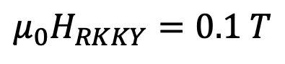
Mumax simulation
Parameters
Output
A_{ex} = 12 x 10⁻¹² J/m
M_{sat} = 10⁶ A/m
K_{eff} = 0 J/m³
DMI = 1.8 x 10⁻³ J/m²
Stray field
Magnetisation
Vacuum x 8
24nm
Ir/Fe/Co/Pt
Ir/Fe/Co/Pt
3nm
$$μ_{0}H_{RKKY}=0.1 T$$
PBC(2,2,0)

Slide 5
Superconducting Quantum Interference Device (SQUID)

Slide 6
TIMARIS

Slide 7
Outline
Part I
Mumax simulations
Visualising stray field of magnetic textures
Determine thickness of chiral layer
Part II
Optimising Niobium deposition condition
AFM measurements (Determine roughness)
SQUID measurements (Determine T_{C})

Slide 8
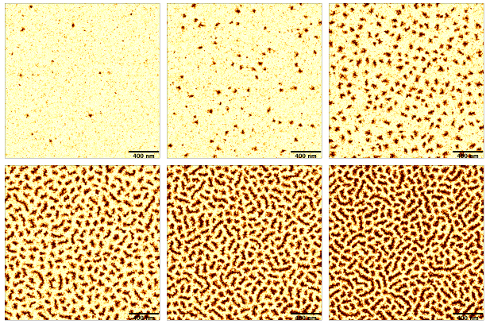
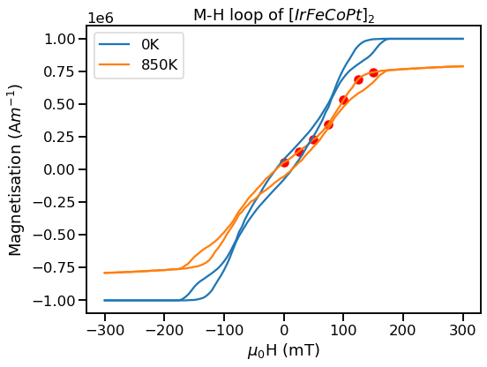
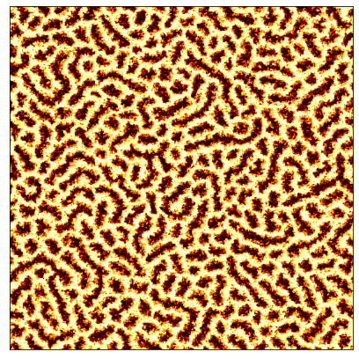
Results & Discussion
150mT
125mT
100mT
75mT
50mT
25mT
0mT

Slide 9
Results & Discussion
0mT
150mT
25mT
125mT
75mT
100mT
50mT

Slide 10
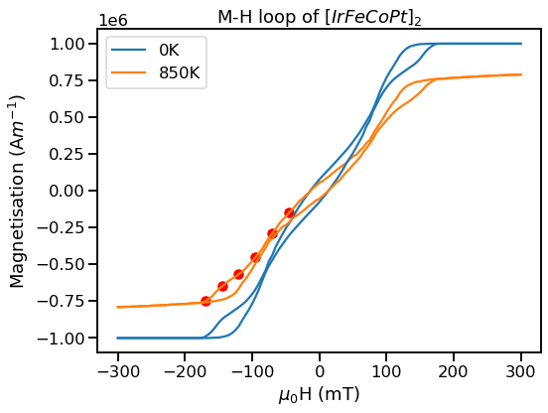
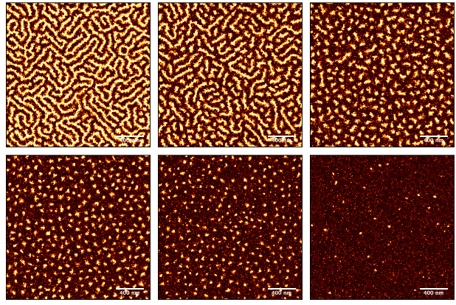
Results & Discussion
-45mT
-70mT
-95mT
-120mT
-145mT
-170mT

Slide 11
Results & Discussion
-170mT
-45mT
-145mT
-70mT
-120mT
-95mT

Slide 12
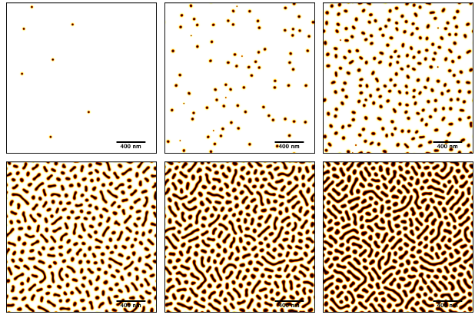
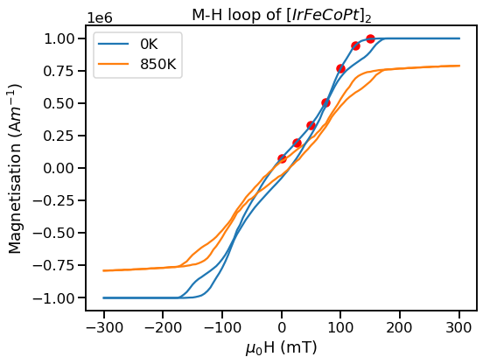
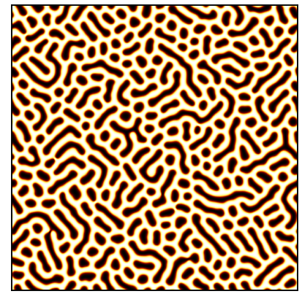
Results & Discussion
150mT
125mT
100mT
75mT
50mT
25mT
0mT

Slide 13
Results & Discussion
0mT
150mT
25mT
125mT
50mT
75mT
100mT

Slide 14
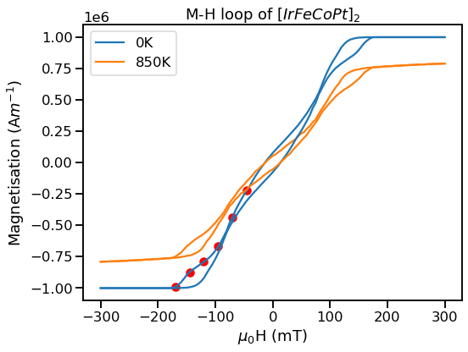
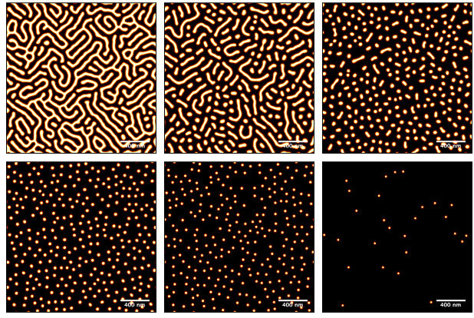
Results & Discussion
-45mT
-70mT
-95mT
-120mT
-145mT
-170mT

Slide 15
Results & Discussion
-170mT
-45mT
-145mT
-70mT
-120mT
-95mT

Slide 16
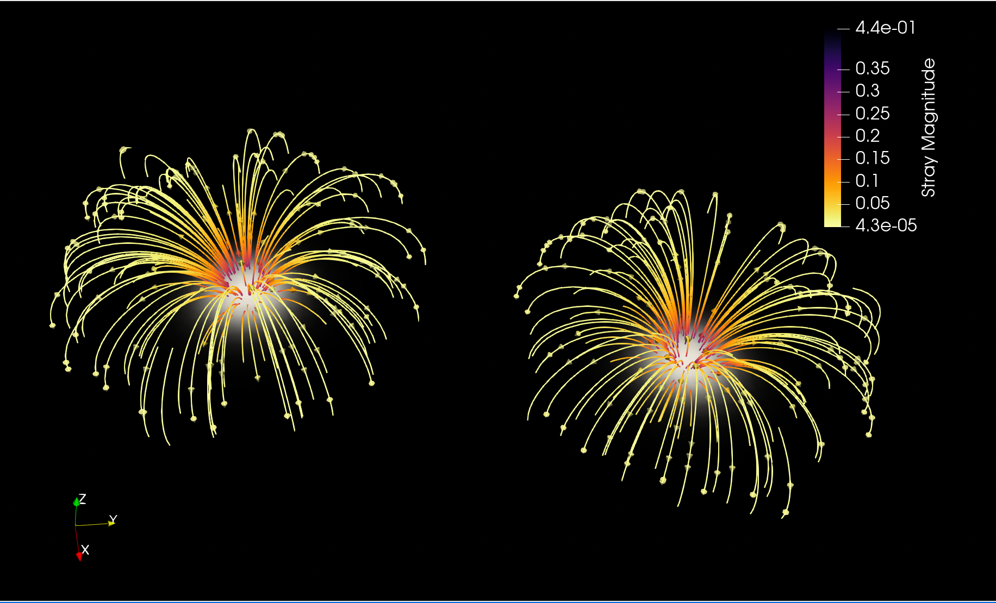
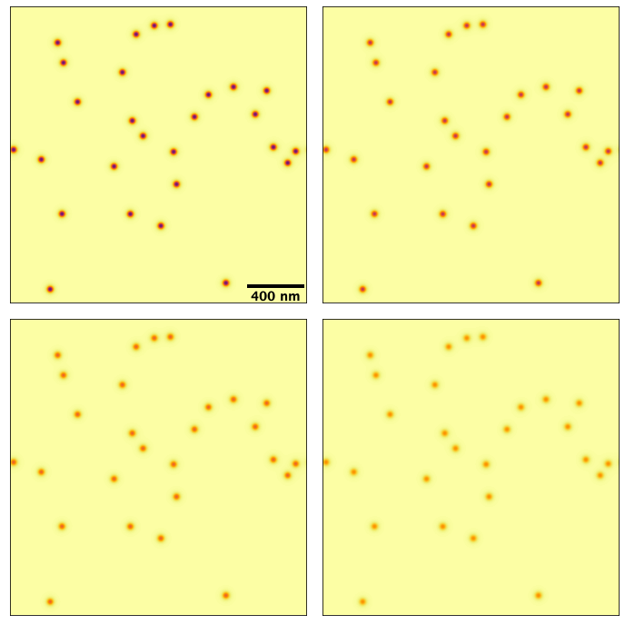
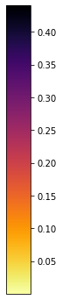
Stray field visualisation
-170mT
3nm
6nm
Magnitude of stray field
9nm
12nm

Slide 17
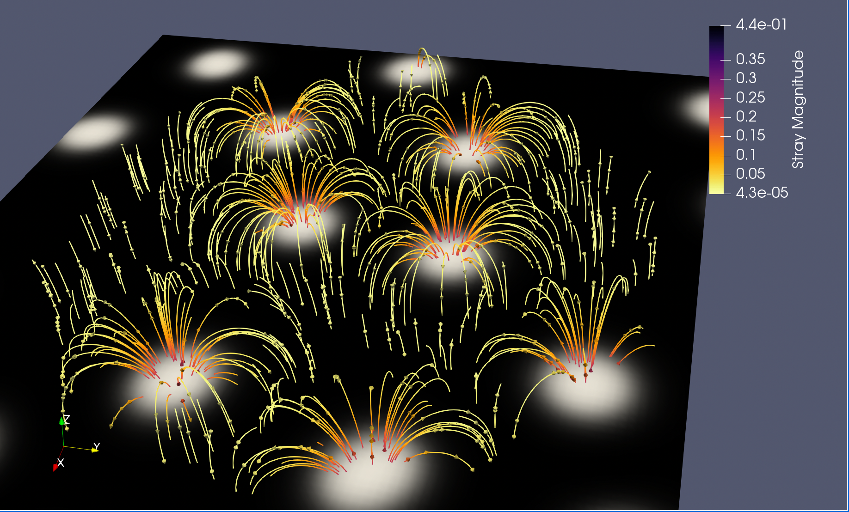
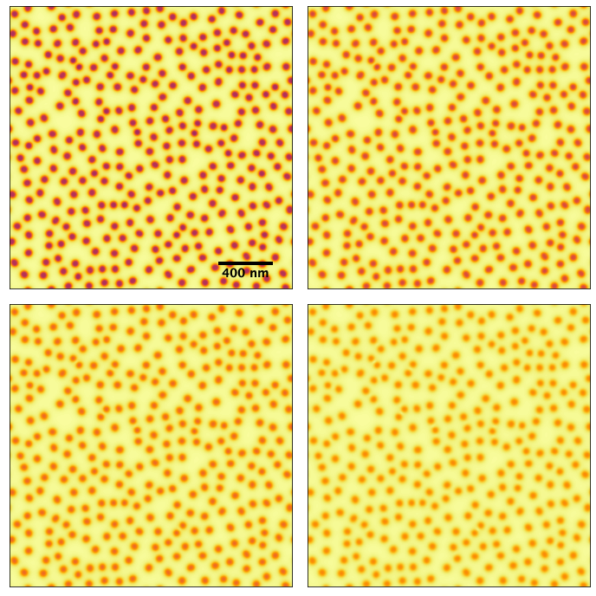
Stray field visualisation
-120mT
3nm
6nm
Magnitude of stray field
9nm
12nm

Slide 18
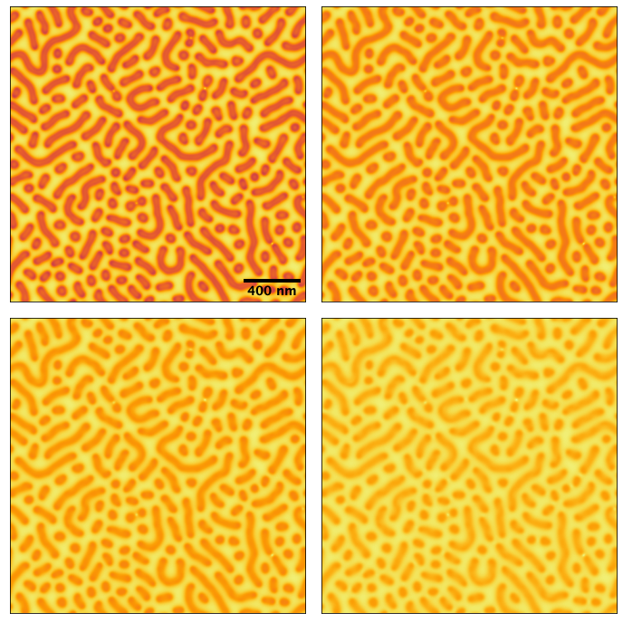
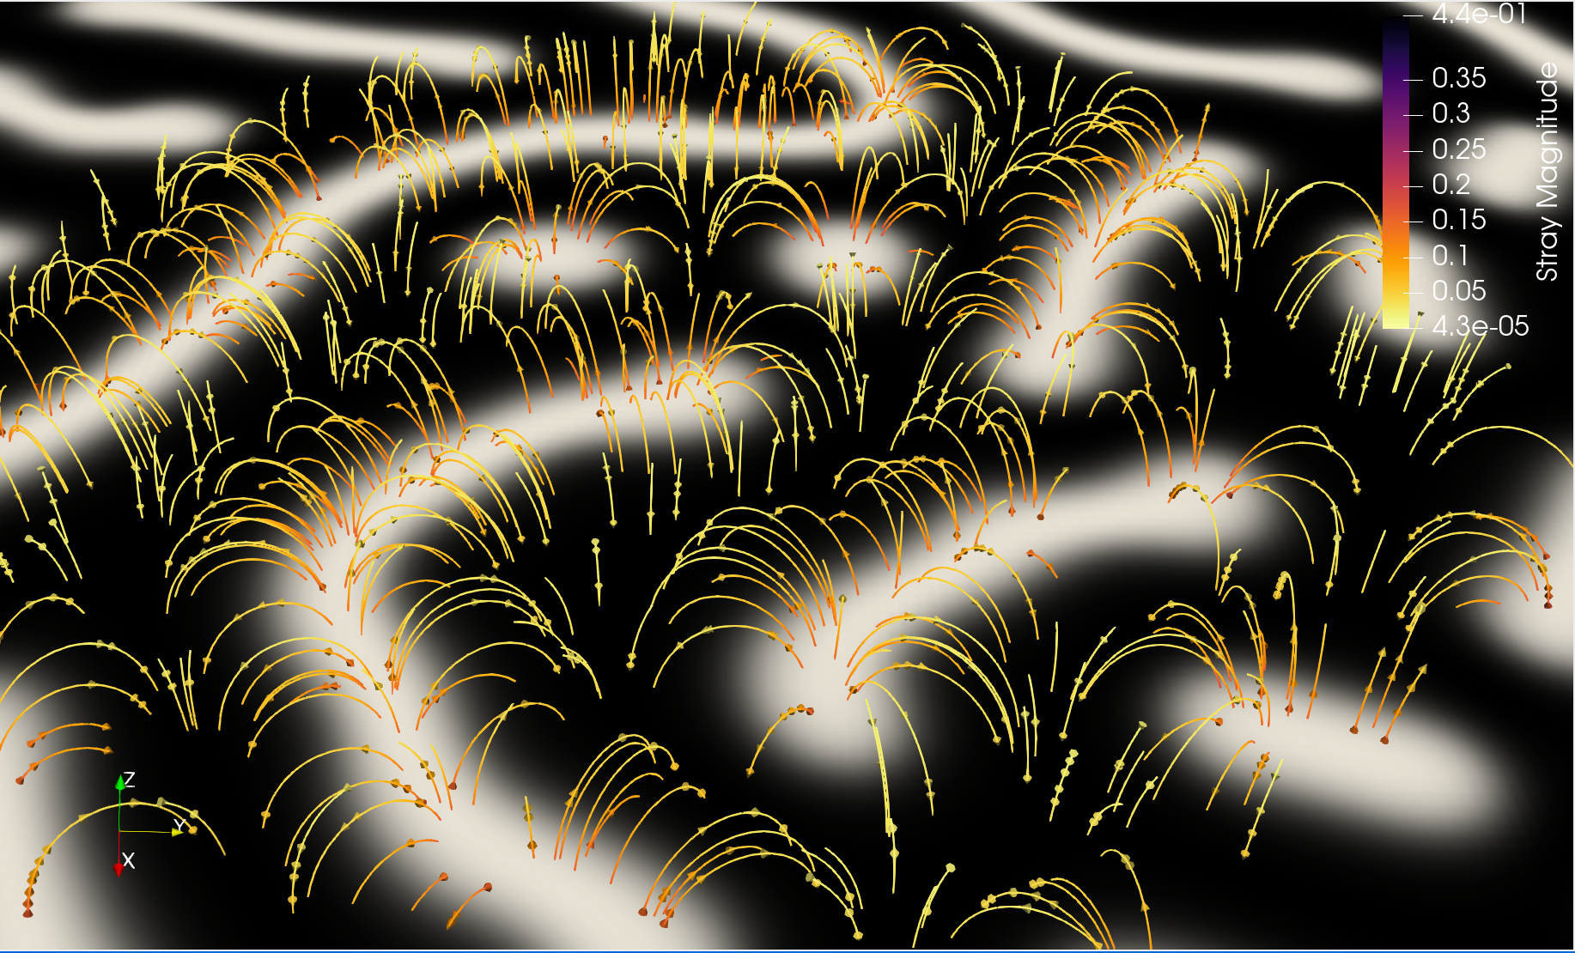
Stray field visualisation
-70mT
3nm
6nm
Magnitude of stray field
9nm
12nm

Slide 19
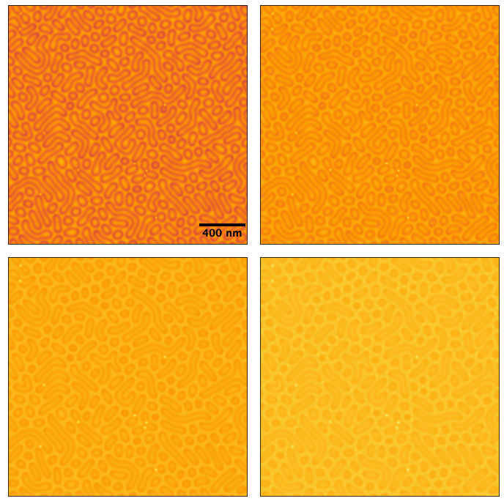
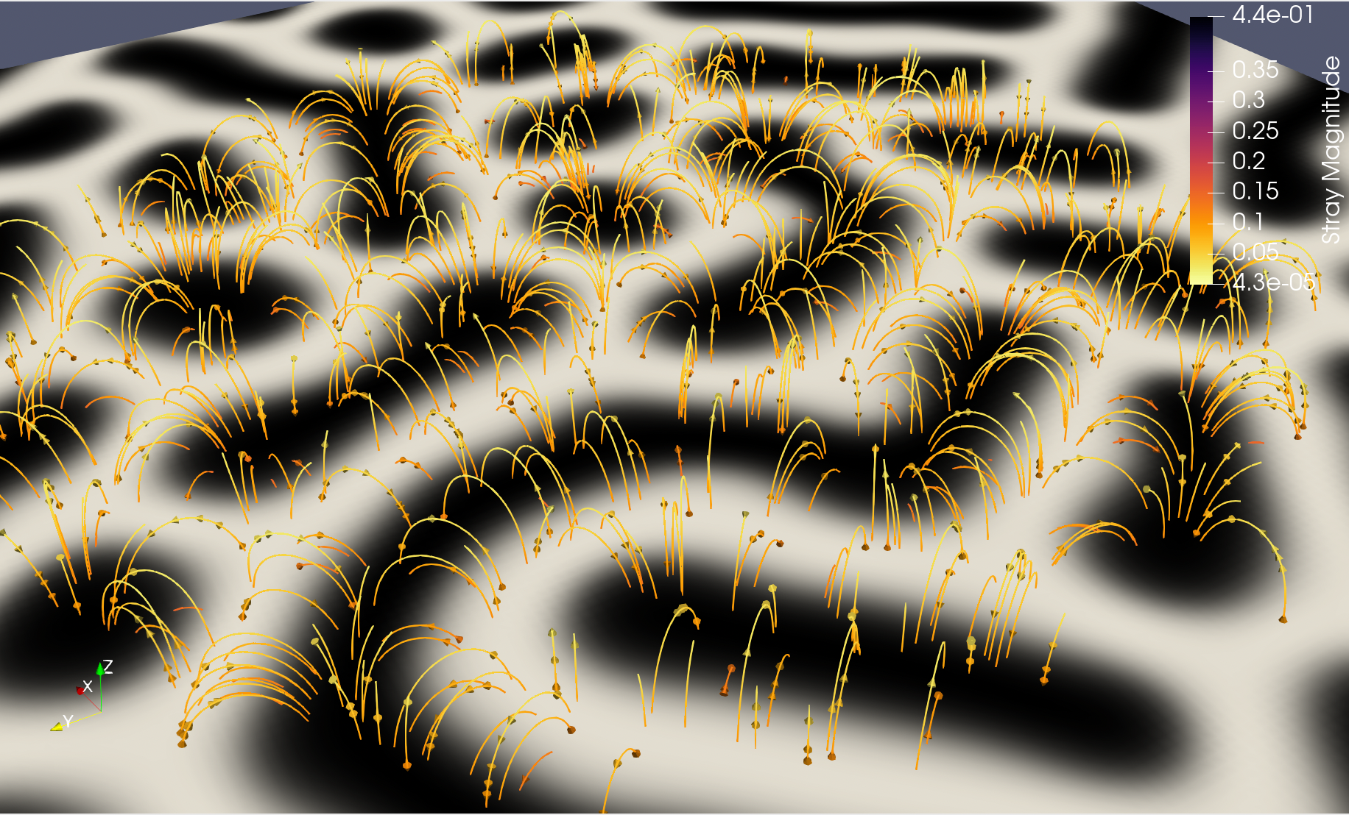
Stray field visualisation
0mT
3nm
6nm
Magnitude of stray field
9nm
12nm

Slide 20
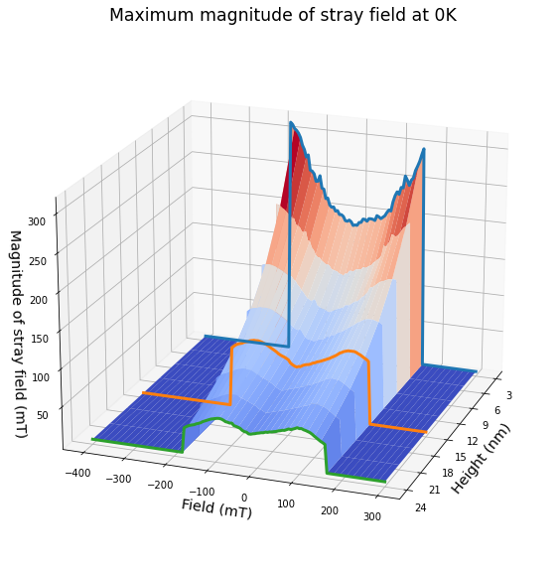
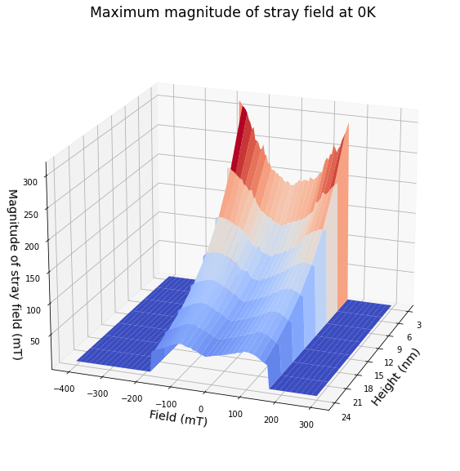
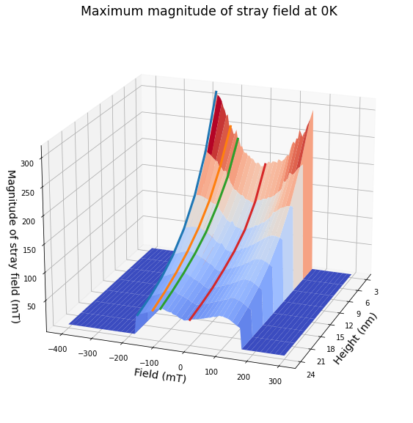
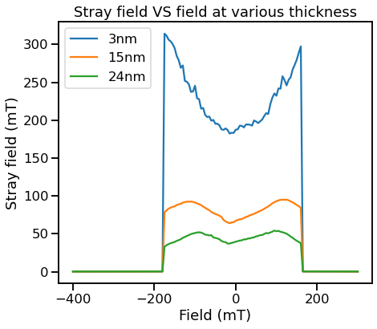
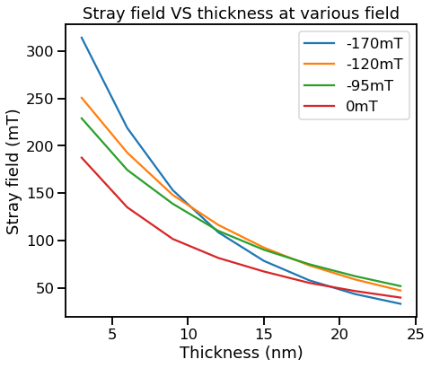
Stray field across field and height

Slide 21
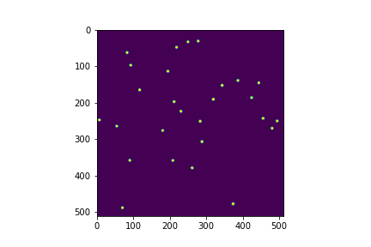
Threshold images at -170mT
3nm
6nm
9nm
12nm
15nm
18nm
21nm
24nm

Slide 22
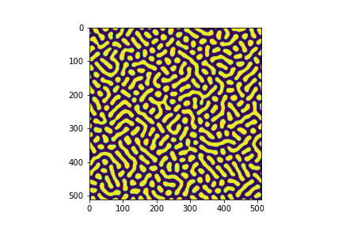
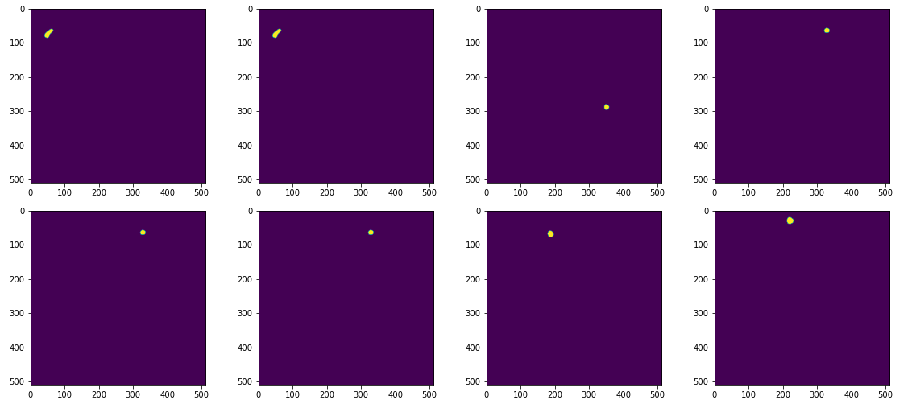
Threshold images at 0mT
3nm
6nm
9nm
12nm
15nm
18nm
21nm
24nm

Slide 23
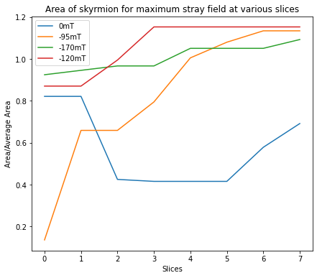
Trend of area skyrmions

Slide 24
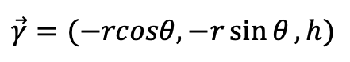
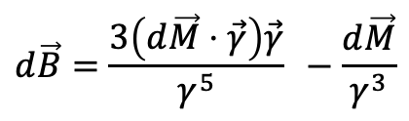
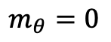
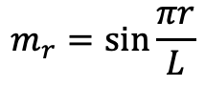
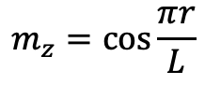
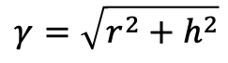
Modelling skyrmion stray field
$$m_{z}=\cos{\frac{πr}{L}}$$
$$\vec{γ}=(−rcosθ, −r\sin{θ},h)$$
$$γ=\sqrt{r^{2}+h^{2}}$$
$$m_{r}=\sin{\frac{πr}{L}}$$
$$m_{θ}=0$$
$$d\vec{B}=\frac{3\left(d\vec{M}⋅\vec{γ}\right)\vec{γ}}{γ^{5}} −\frac{d\vec{M}}{γ^{3}}$$

Slide 25
Outline
Part I
Mumax simulations
Visualising stray field of magnetic textures
Determine thickness of chiral layer
Part II
Optimising Niobium deposition condition
AFM measurements (Determine roughness)
SQUID measurements (Determine T_{C})

Slide 26
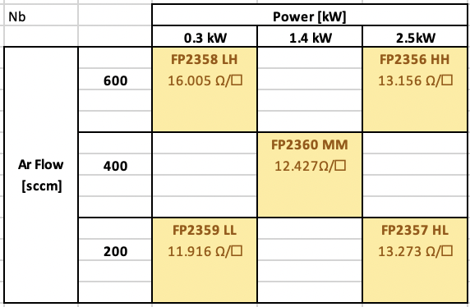
Deposition conditions

Slide 27
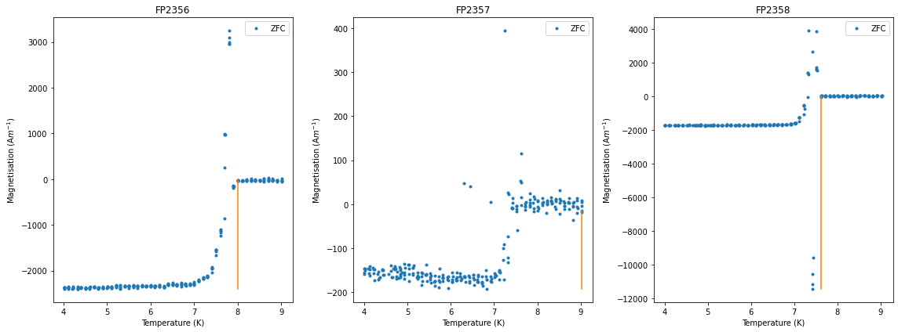

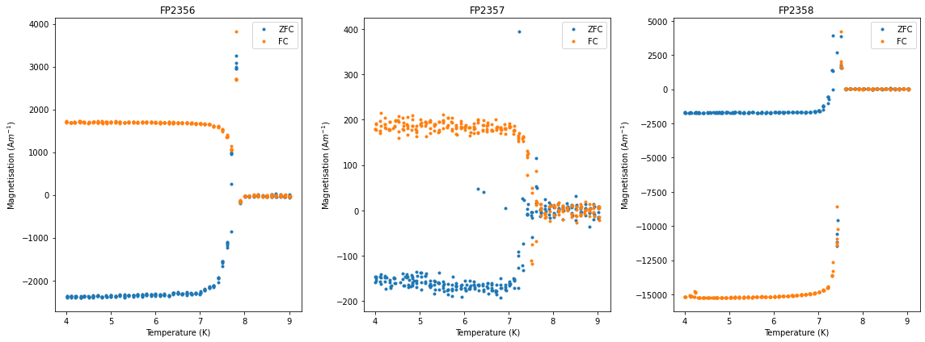
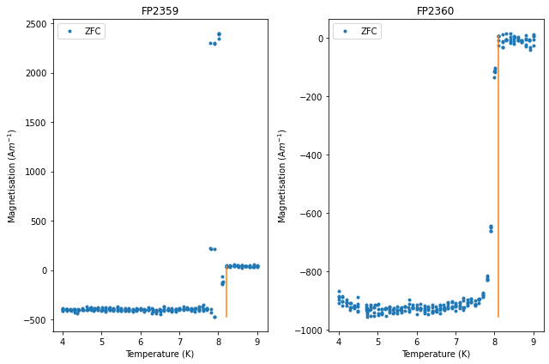
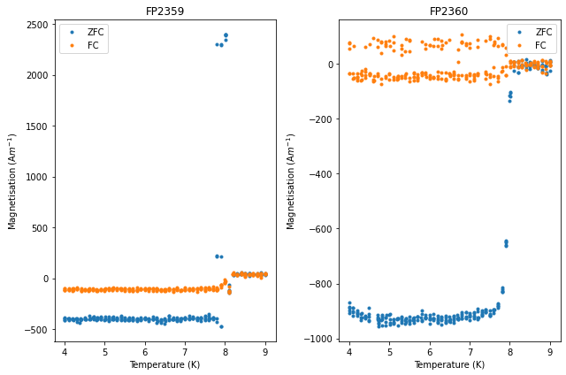
SQUID results

Slide 28
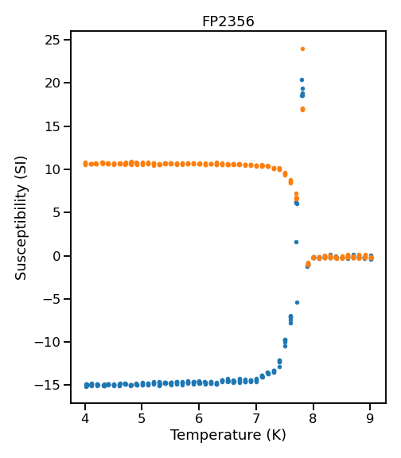
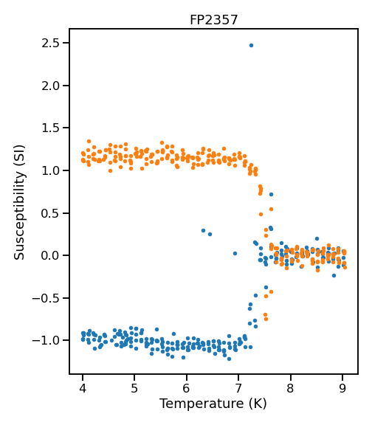
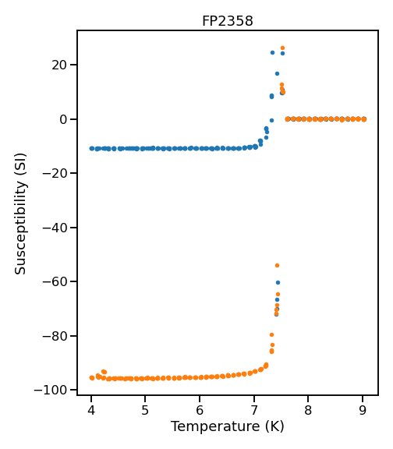
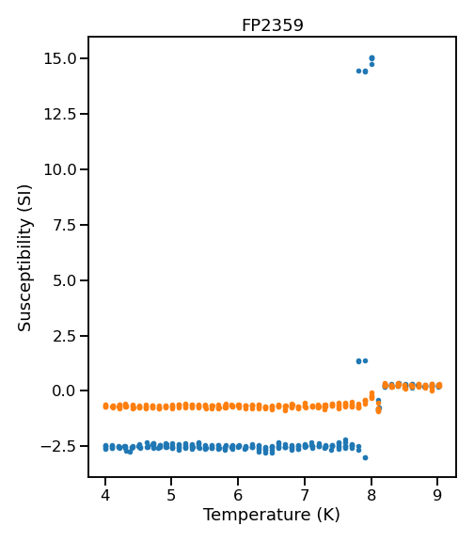
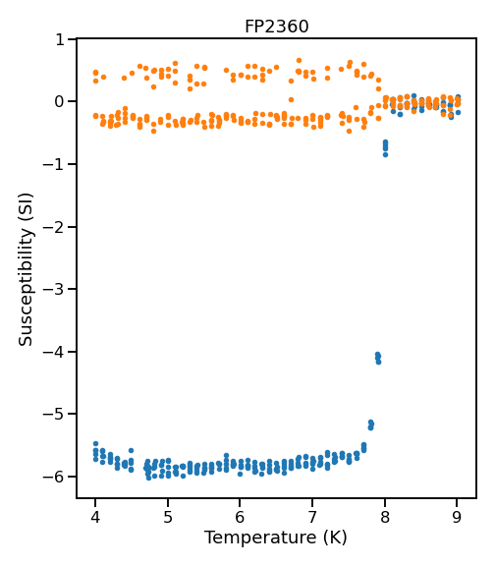
SQUID results

Slide 29
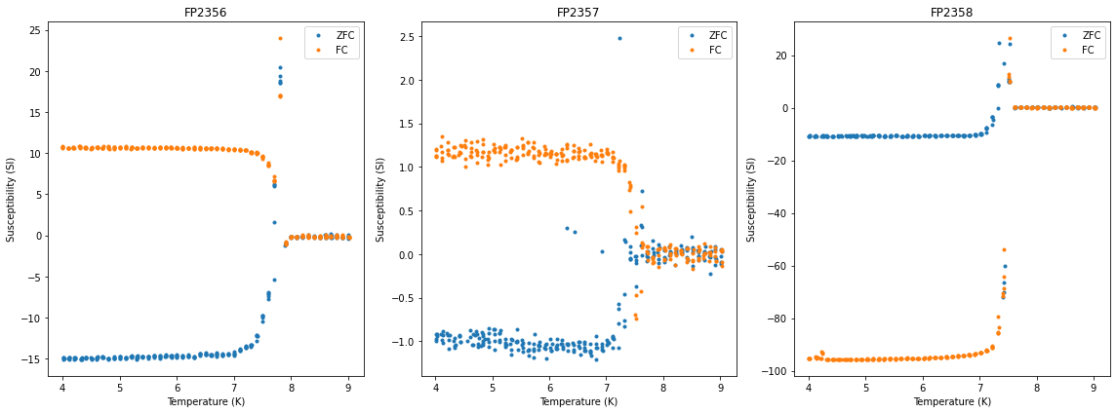
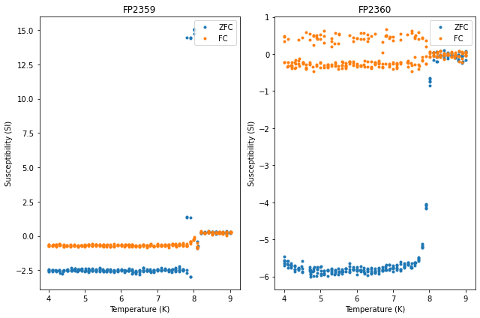
SQUID results

Slide 30
Summary
Power (kW)
 | 0.3 | 1.4 | 2.5
600 | FP2358 Sheet resistance: 16.005 Ω/□ Roughness: 309.8 pm Thickness: 20.8 nm Critical Temperature: 7.6 K |  | FP2356 Sheet resistance: 13.156 Ω/□ Roughness: 298.4 pm Thickness: 22.2 nm Critical Temperature: 8.0 K
400 |  | FP2360 Sheet resistance: 12.427 Ω/□ Roughness: 204.3 pm Thickness: 22.8 nm Critical Temperature: 8.1 K
200 | FP2359 Sheet resistance: 11.916 Ω/□ Roughness: 242.6 pm Thickness: 23.3 nm Critical Temperature: 8.2 K |  | FP2357 Sheet resistance: 13.273 Ω/□ Roughness: 203.7 pm Thickness: 22.2 nm Critical Temperature: 7.6 K
Ar Flow
[sccm]

Slide 31
Stray field visualisation

Slide 32
Summary

Slide 33
Future Work/Directions

